Slide 1
CLAIM REQUEST SYSTEM
GROUP 2

Slide 2
sca
BACKEND
GENERIC REPOSITORY
FACTORY METHOD
BACKEND
BACKEND
BACKEND
BACKEND
AUTO MAPPER
UNIT_OF_WORK
BACKEND
BACKEND
DEPENDENCY INJECTION
MIDDLEWARE
ASP.NET 8
DTO
N_TIER ARCH

Slide 3












FUTURE IS HERE
FRONTEND
A3
A3
ERROR CHECK
ERROR CHECK
Reactjs
Shadcn/ui
Ant design
With Typescript
ERROR CHECK
ERROR CHECK
A3
A3
FUTURE IS HERE

Slide 4
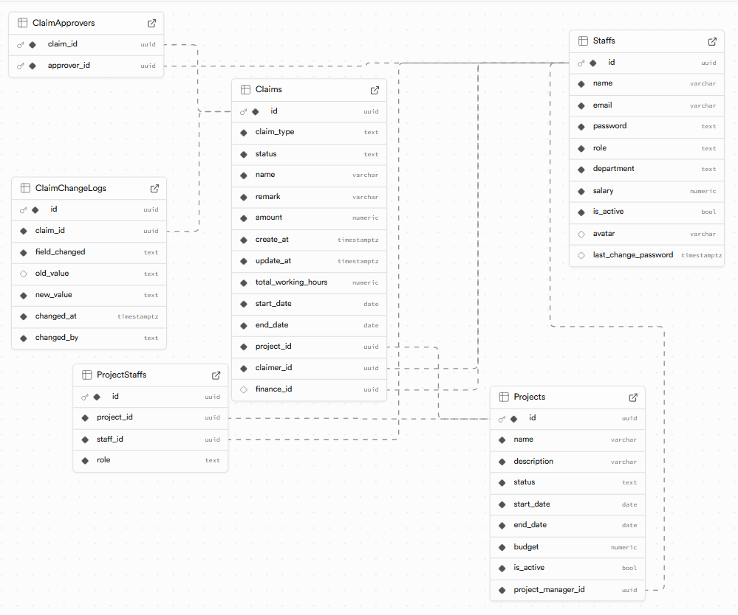
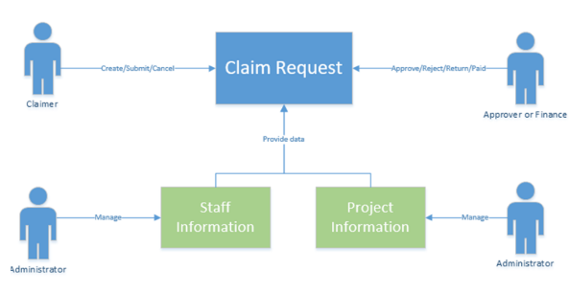
ERD & ORD

Slide 5
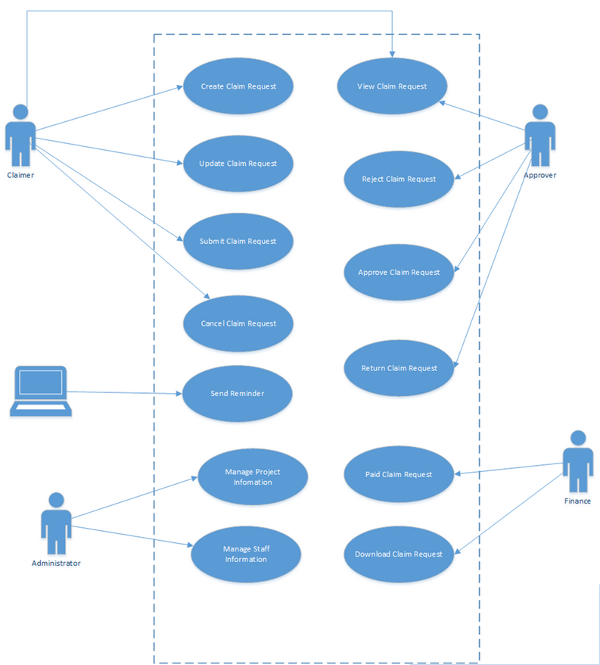
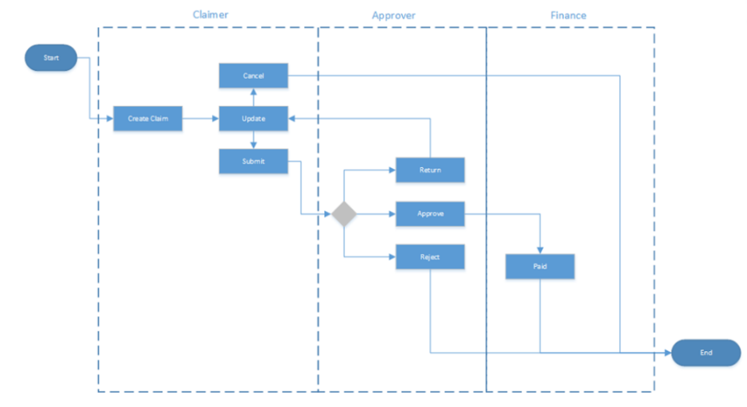
FUNCTION

Slide 6
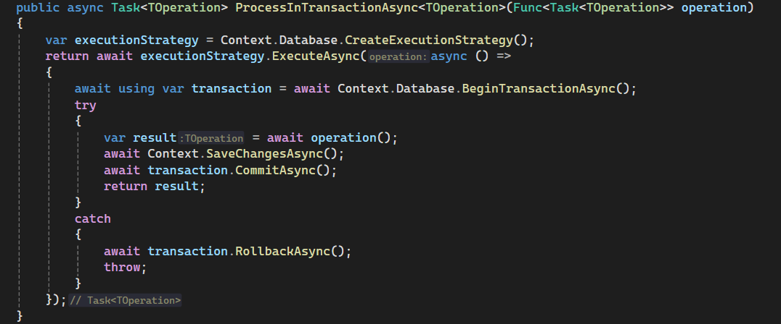
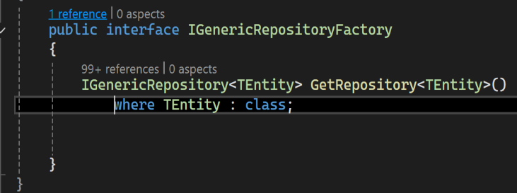
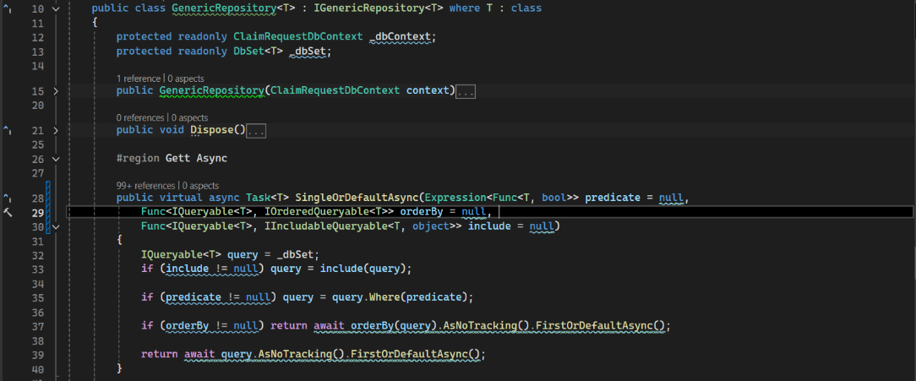
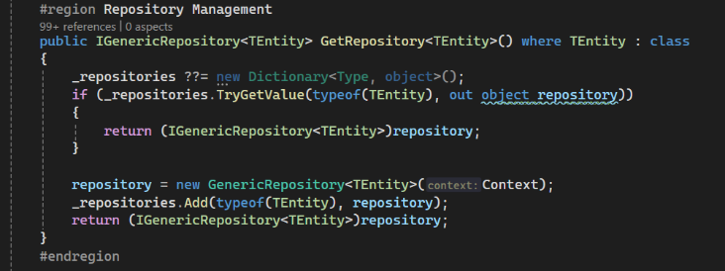
Factory Method
UnitOfWork
GenericRepo
Concrete Method
For factory

Slide 7
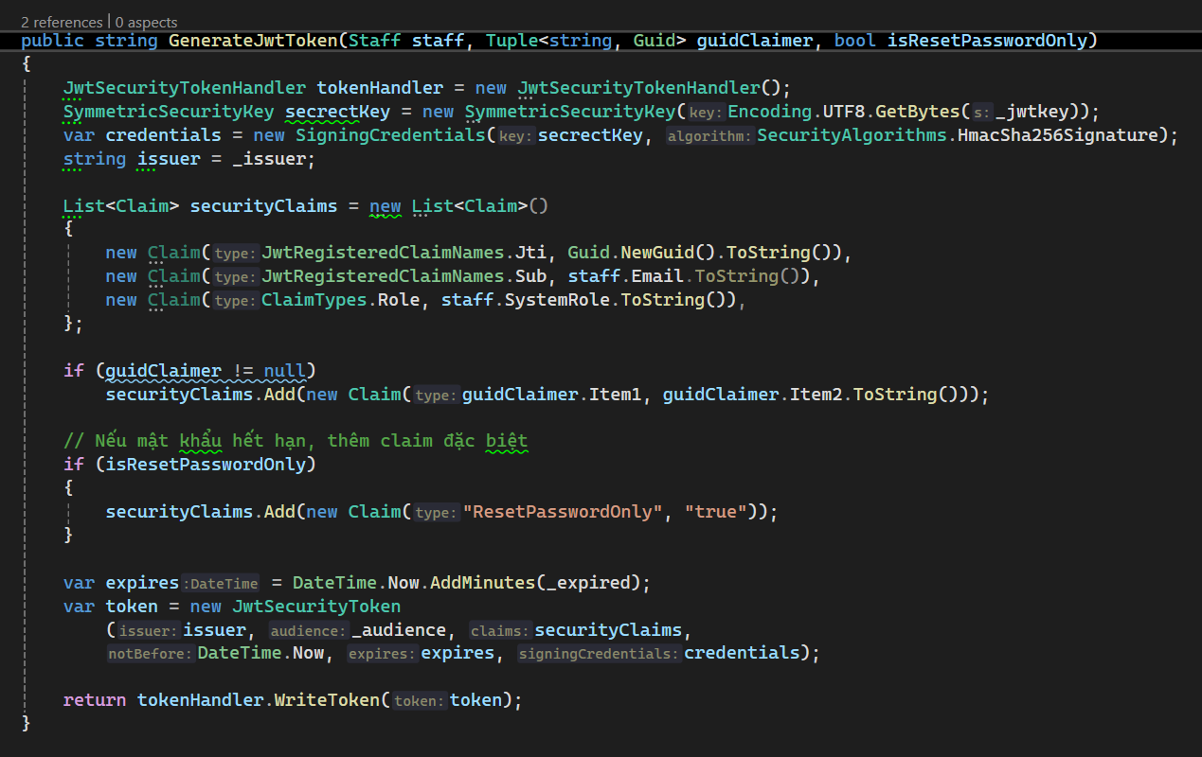
JWT
token

Slide 8
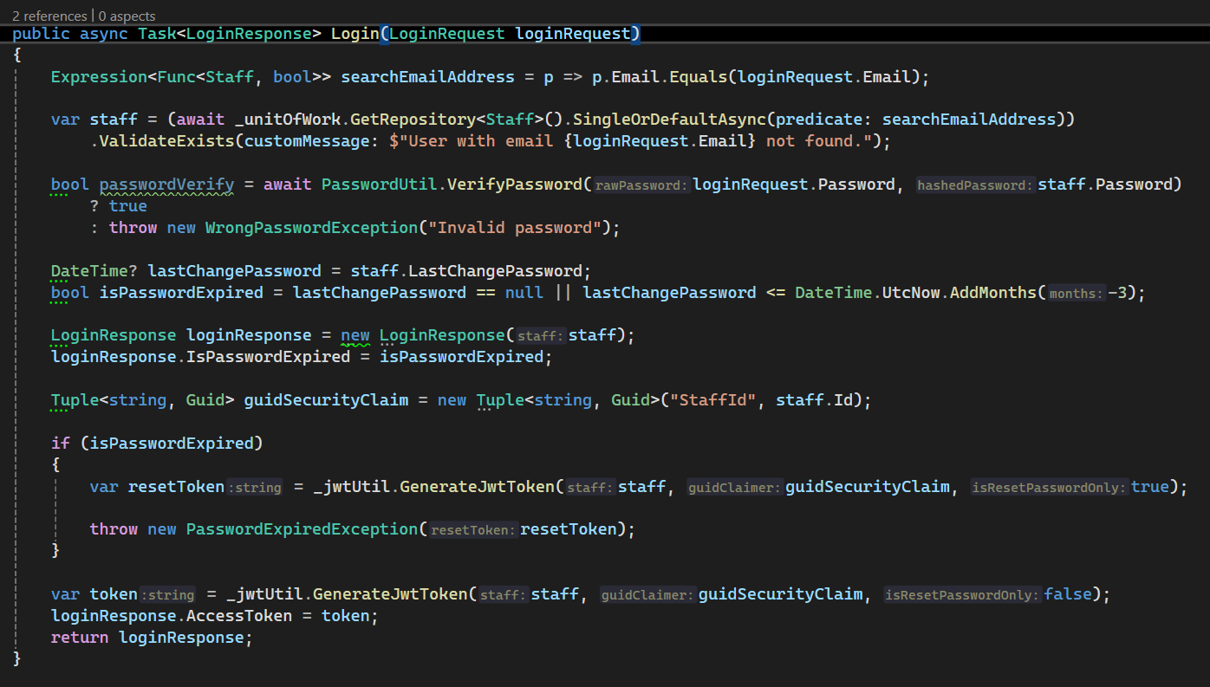
Auth
Service

Slide 9
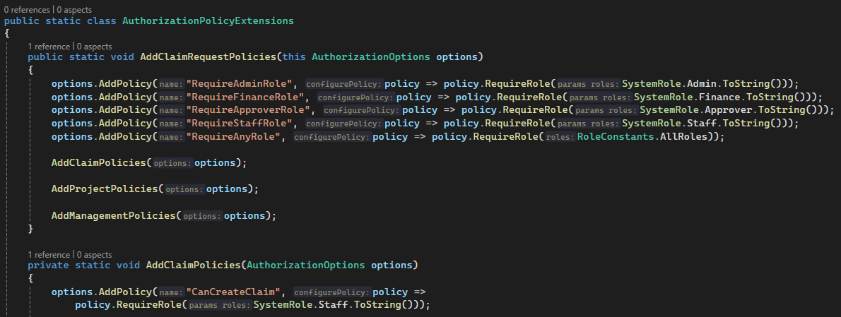
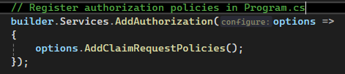
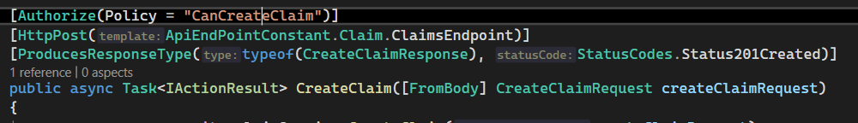
Auth
Policy

Slide 10
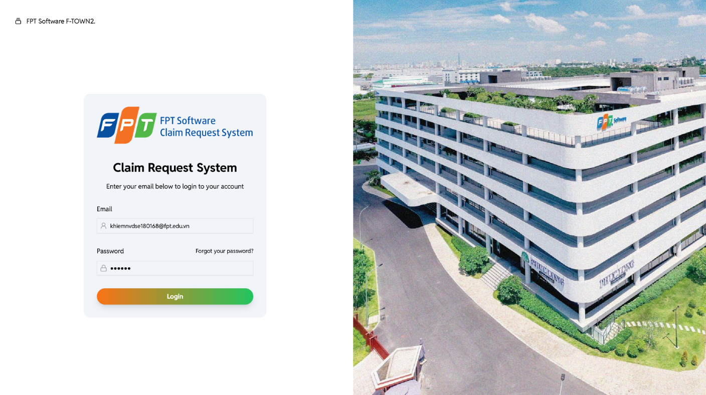
Login
Page

Slide 11
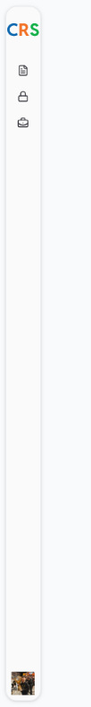
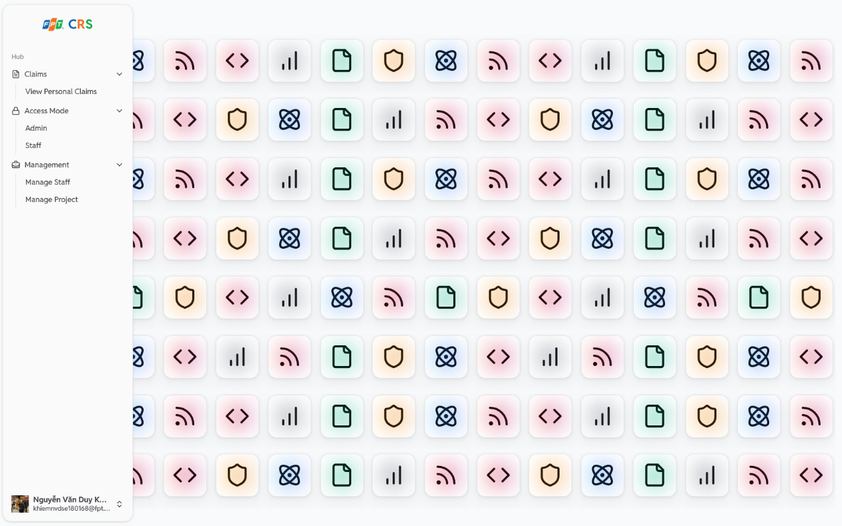
Dynamic
Sidebar

Slide 12
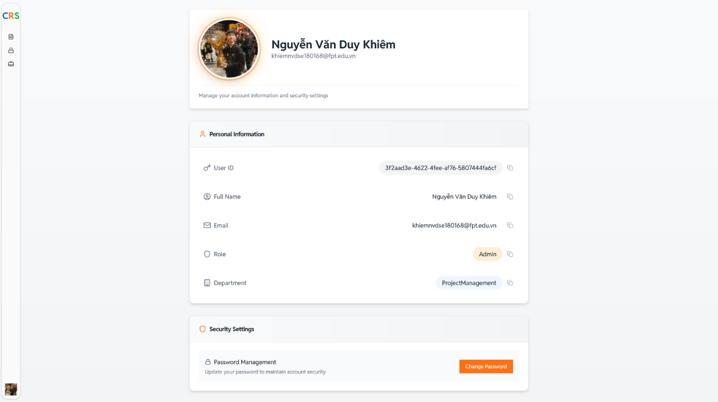
USER
Information
page

Slide 13
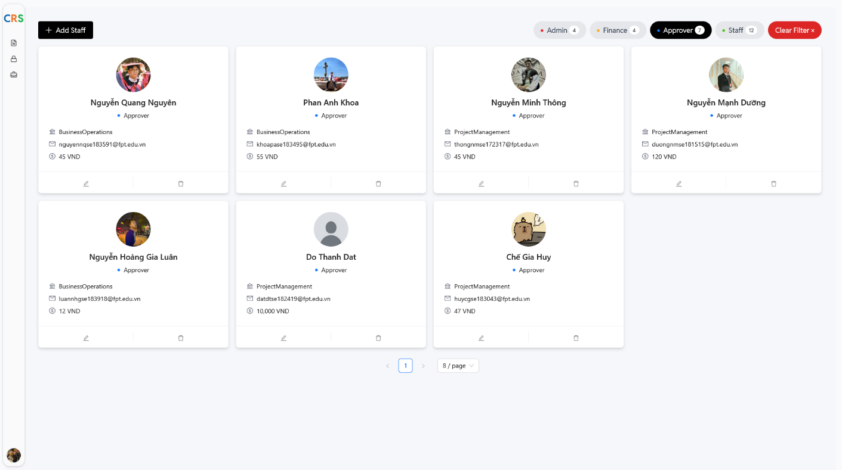
STAFF Manager
page

Slide 14
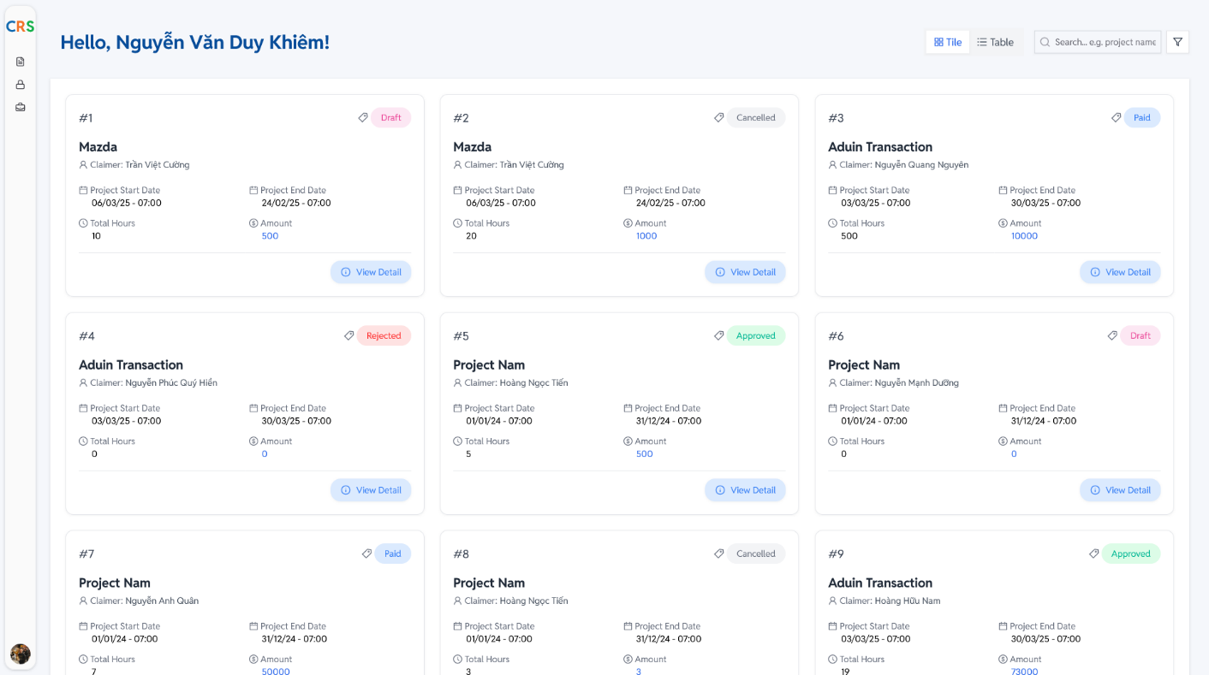
Claim
Tile View

Slide 15
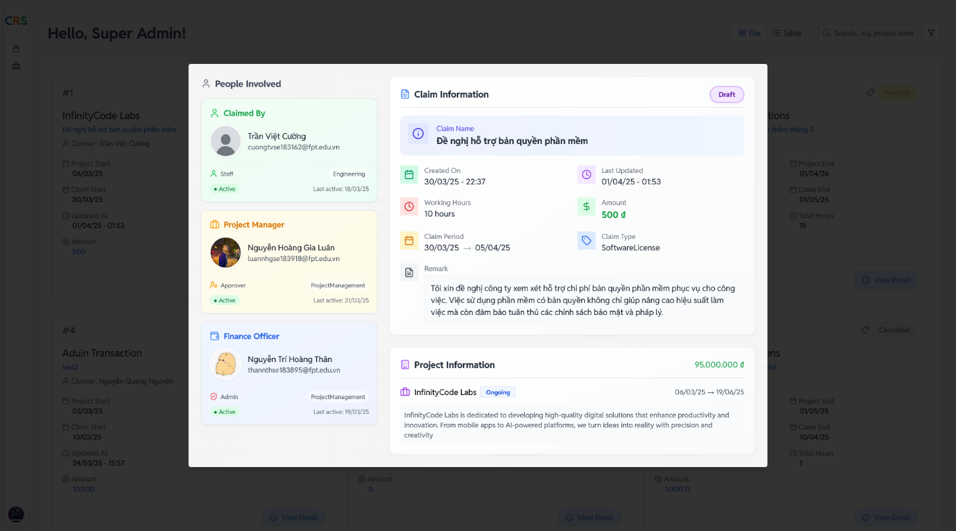
Claim
Detail UI

Slide 16
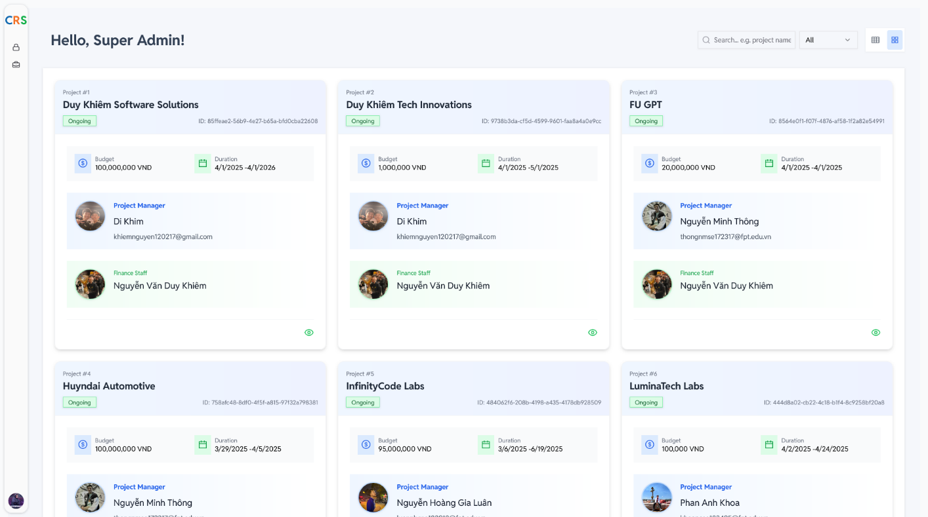
Project
List UI

Slide 17
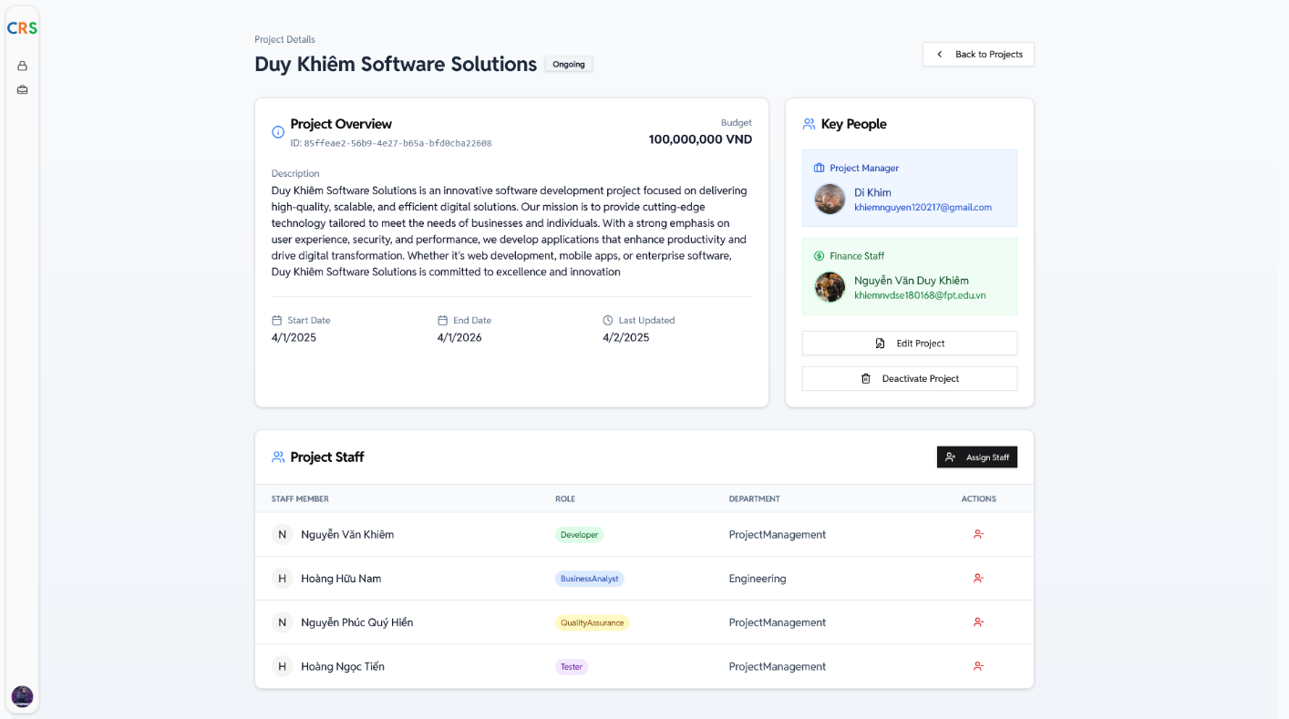
Project
Detail UI

Slide 18
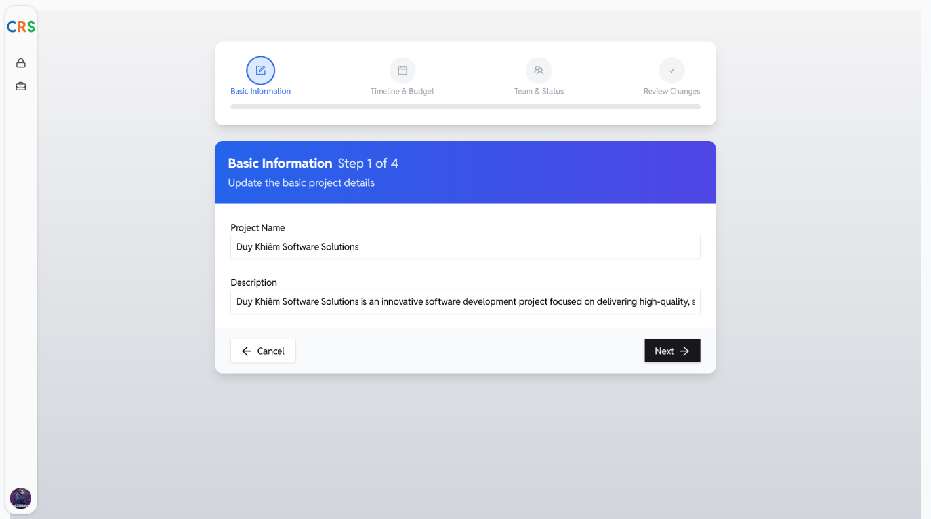
Project
Detail UI

Slide 19
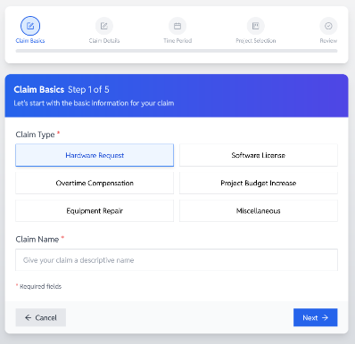
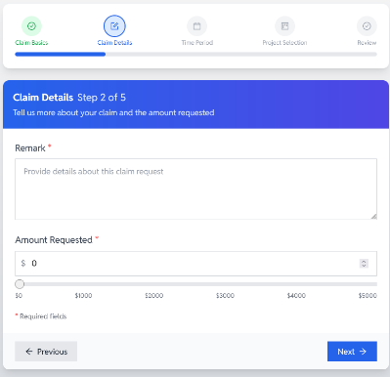
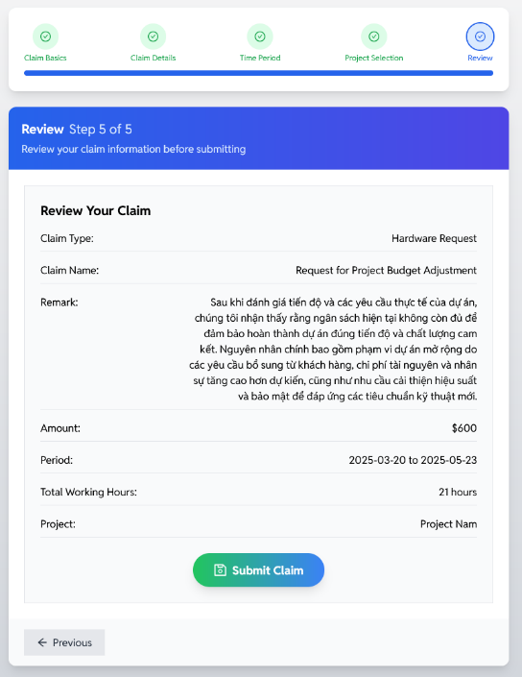
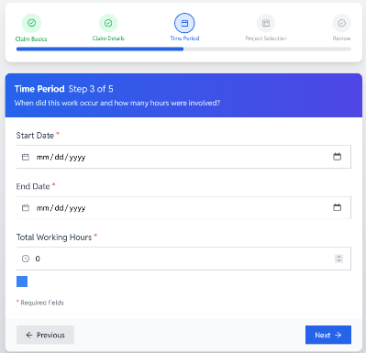
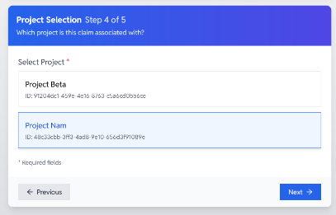
Create
Claim
Wizard

Slide 20
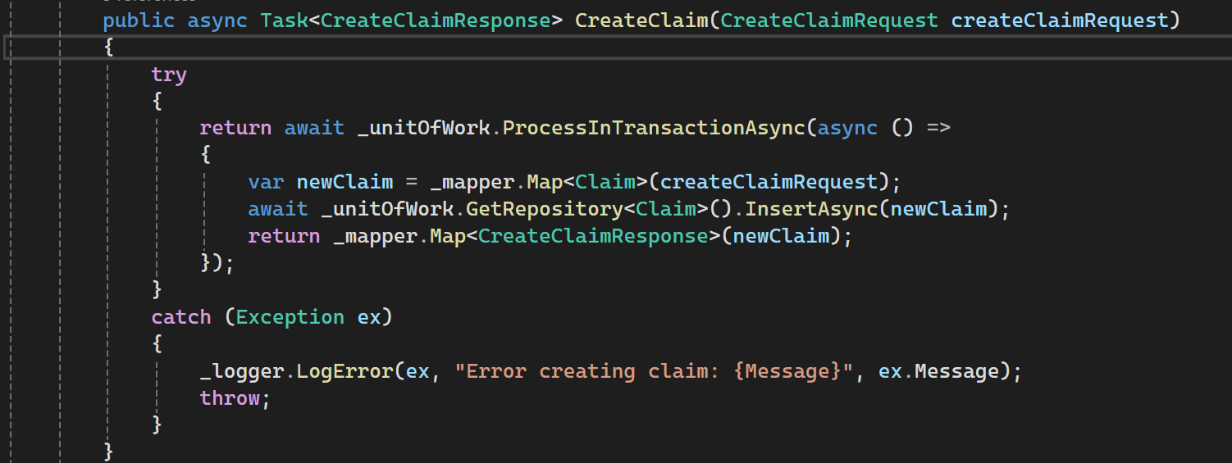
CREATE CLAIM

Slide 21
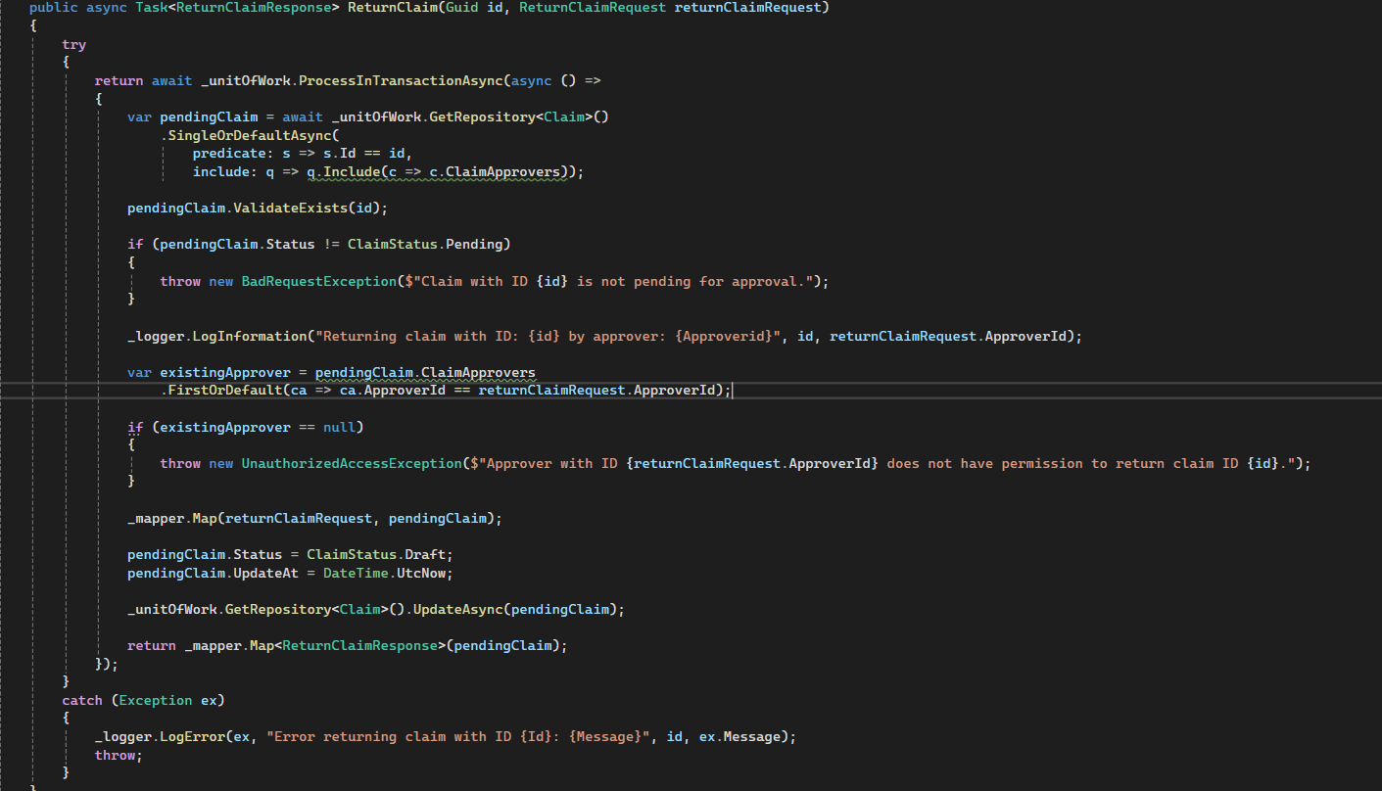
Return Claim

Slide 22
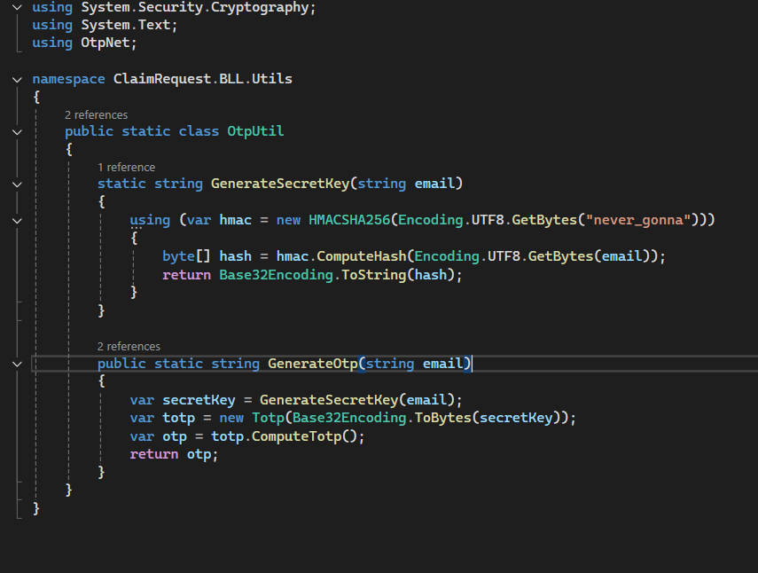
Create Otp

Slide 23
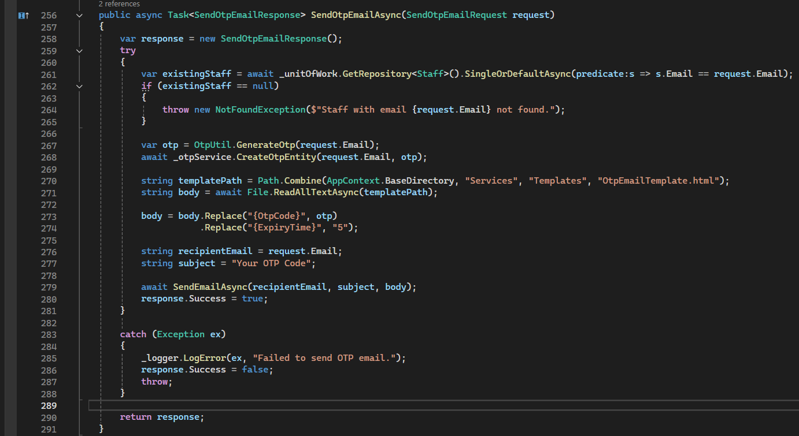
Send Otp email

Slide 24
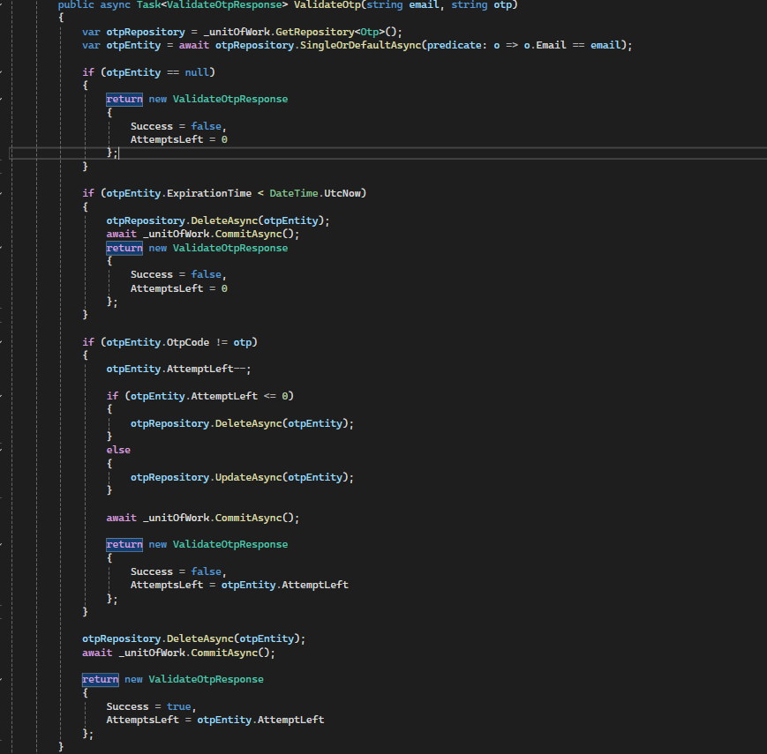
Validate otp

Slide 25
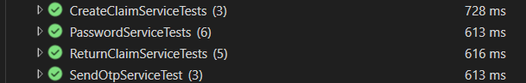
Unit test

Slide 26
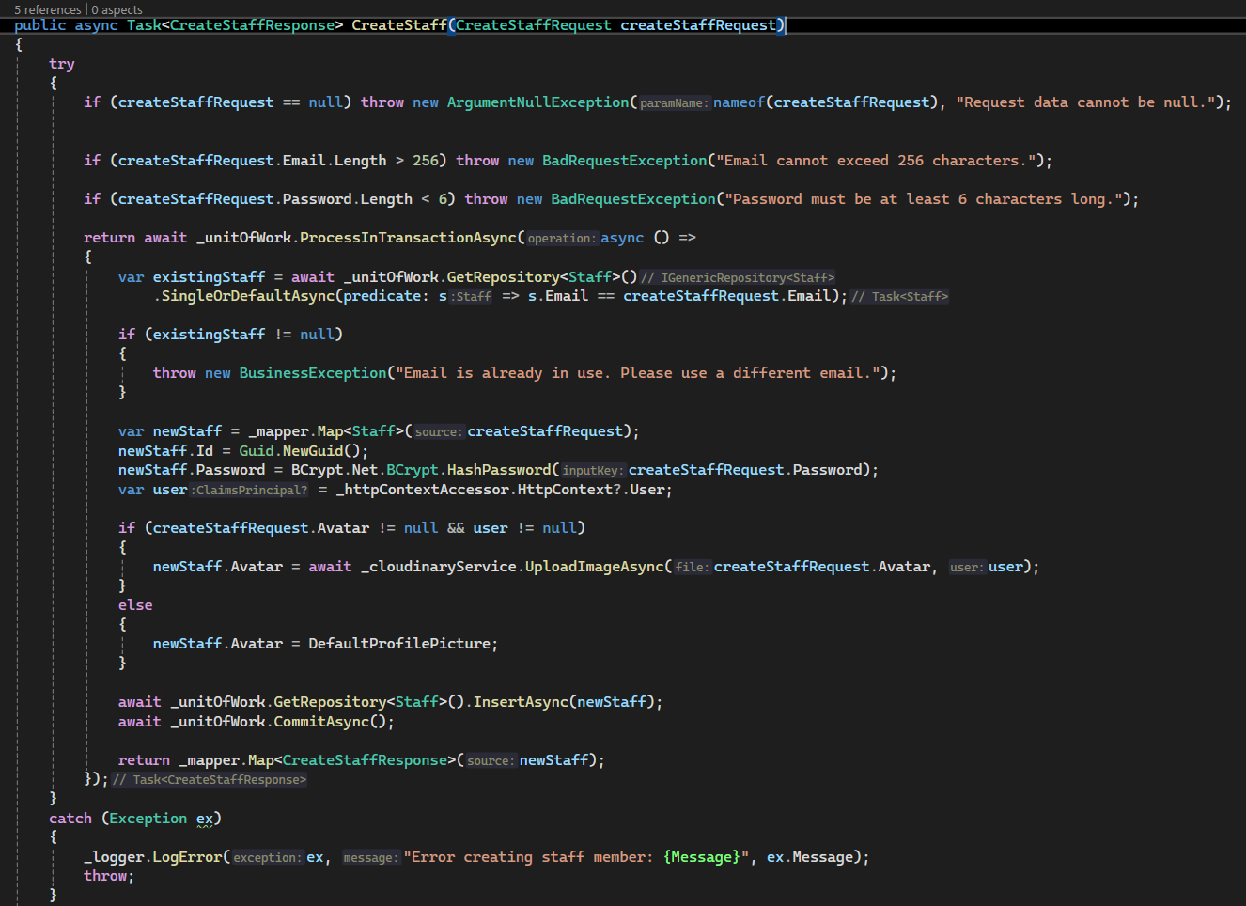
Create
Staff

Slide 27
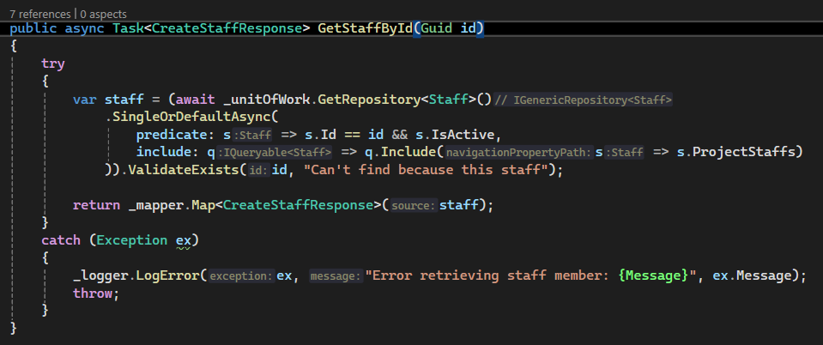
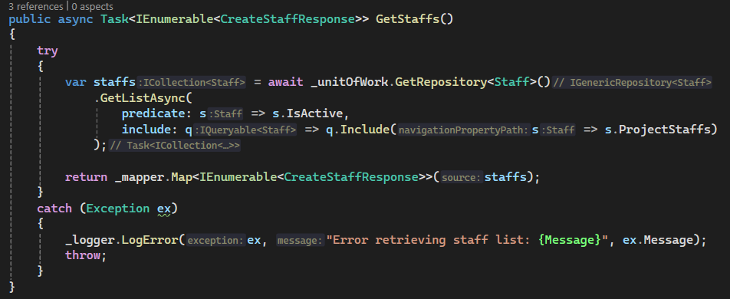
GetStaff
ById
GetS
taffs

Slide 28
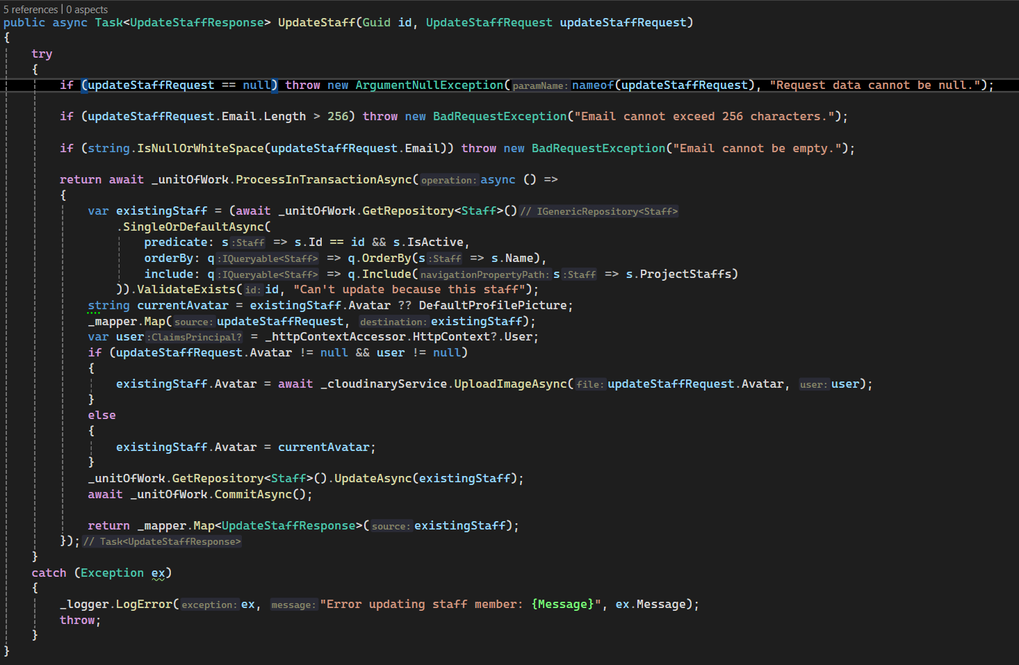
Update
Staff

Slide 29
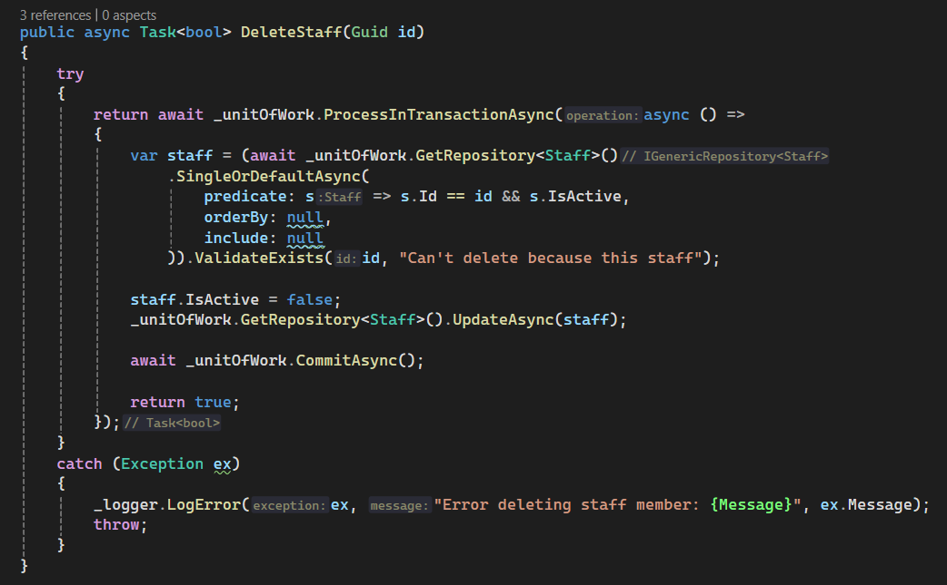
Delete
Staff

Slide 30
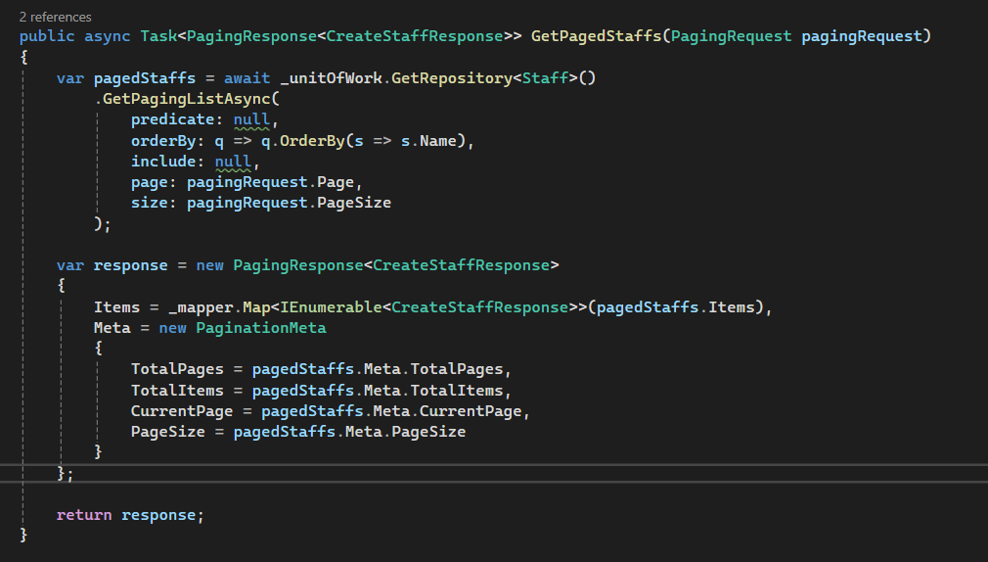
Page
Staff

Slide 31
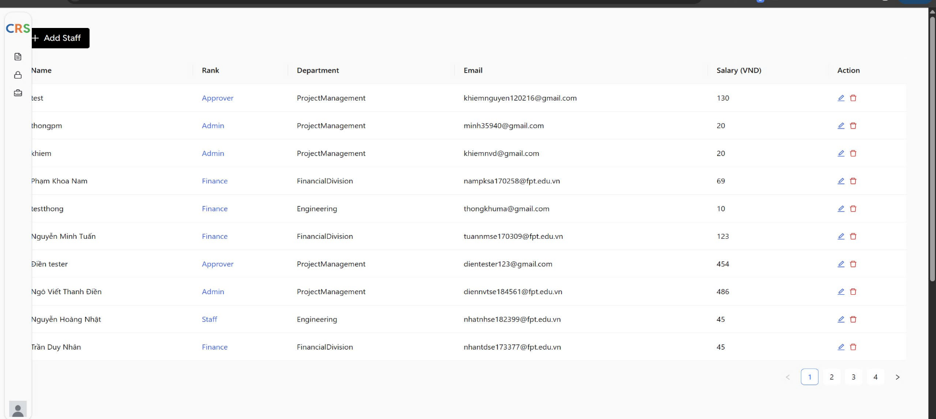
Get and page staff

Slide 32
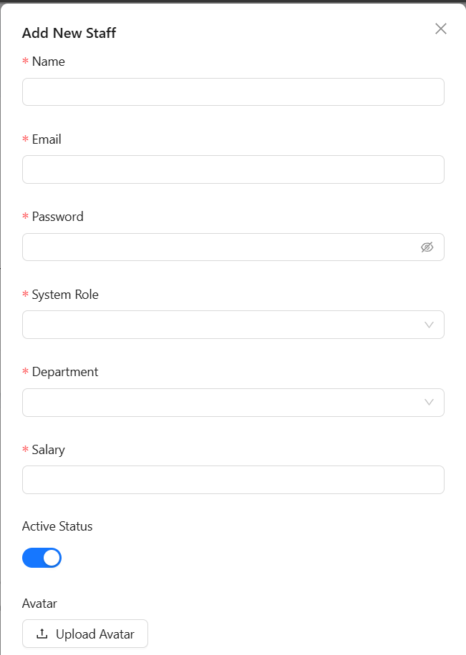
Create staff FE

Slide 33
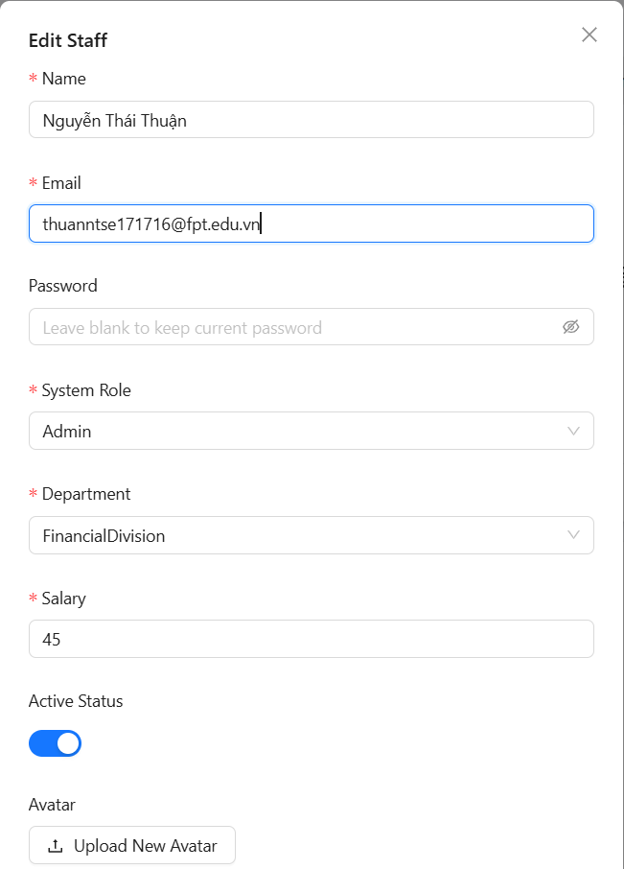
Update staff FE

Slide 34
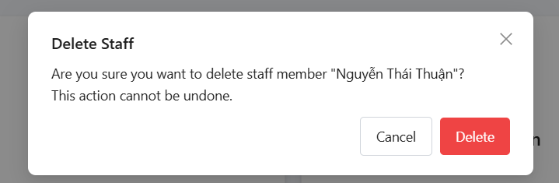
Delete staff FE

Slide 35
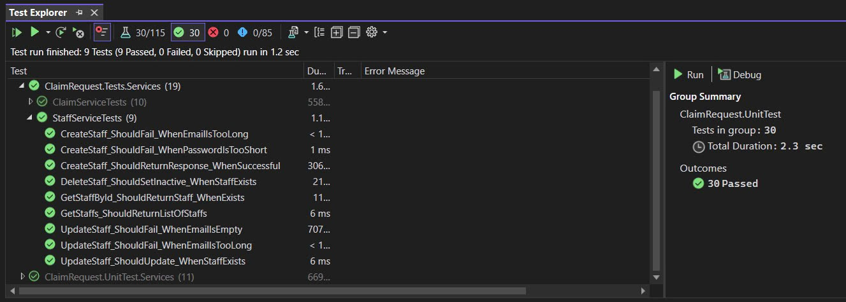
Unit Tests

Slide 36
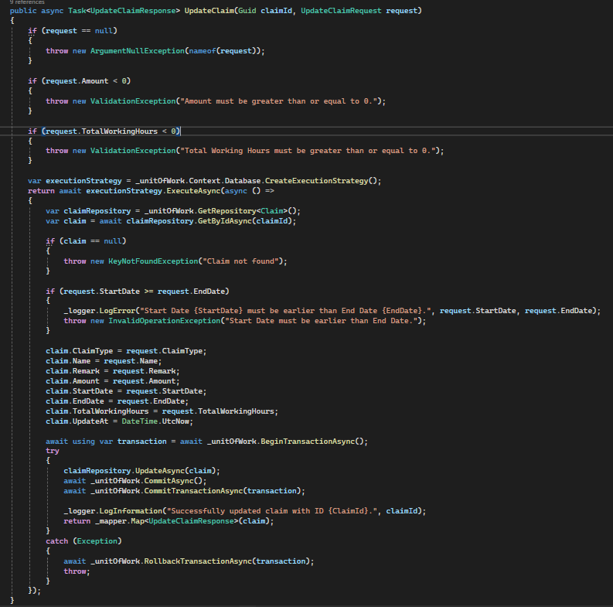
Update
Claim

Slide 37
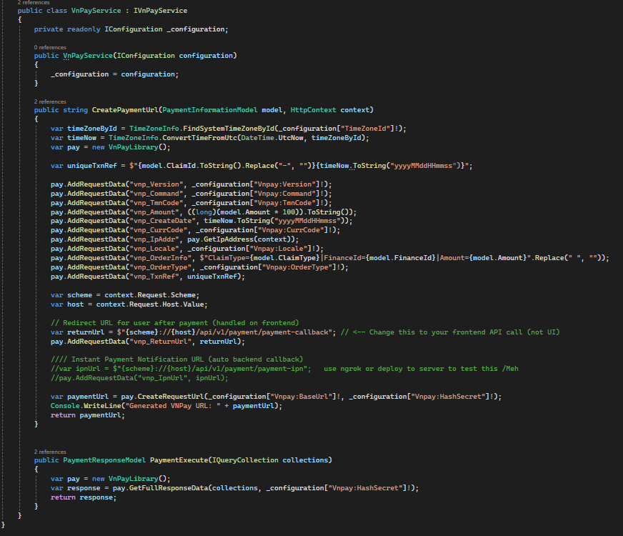
VNPay PAYMENT API
(VNPayService)

Slide 38
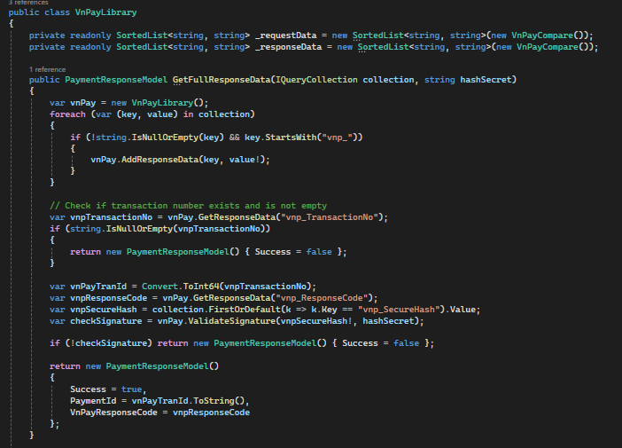
VNPay PAYMENT API
(VNPayLibrary)

Slide 39
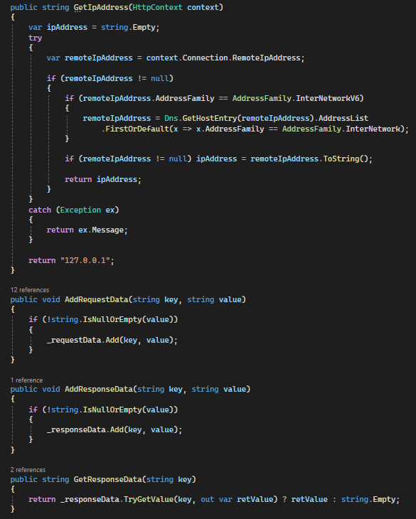
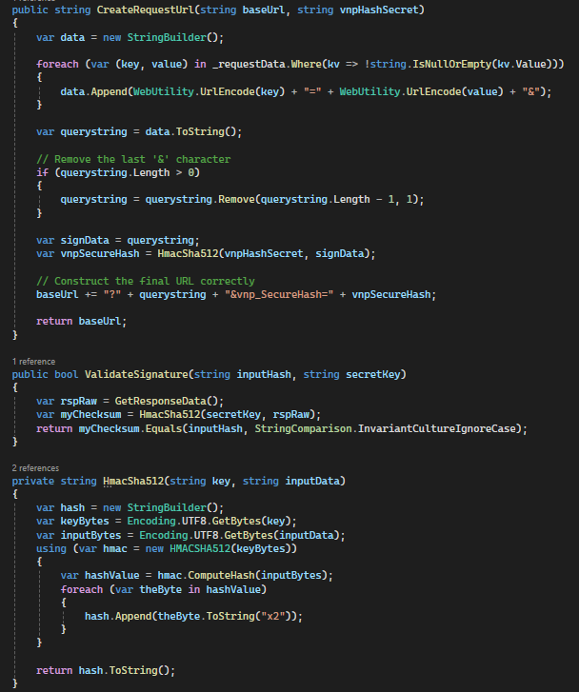
VNPay PAYMENT API
(VNPayLibrary)

Slide 40

VNPay PAYMENT API
(VNPayLibrary)

Slide 41

Reject
Claim

Slide 42


Assign Staff

Slide 43


Remove Staff

Slide 44

Create project

Slide 45

Delete project

Slide 46

Get Project by ID

Slide 47

Get Project (P1)

Slide 48

Get Project (filter)​

Slide 49

Get Project (Sorting)​

Slide 50

Update Project​

Slide 51

CANCEL CLAIM
1. Client sends cancel claim request.
2. Server validates JWT.
3. If valid, extract User ID.
↪ If invalid, return 401 Unauthorized.
5. Server fetches claim using claim Id.
6. If claim exists, return details.
↪ If not, return 404 Not Found.

Slide 52

CANCEL CLAIM
1. Check if claim status is 'Draft'.
↪ If not, return 400 Bad Request.
2. Check if the user is the claimer.
↪ If not, return 403 Forbidden.
3. Begin database transaction.
4. Update claim status to 'Cancelled'.
5. Update timestamp & save remark.
6. Commit transaction.
↪ If failure, rollback transaction.
↪ Return 500 Internal Server Error
⇒ Return 200 OK if success.

Slide 53

DOWNLOAD CLAIM
Validate request.
↪ If invalid, log warning & throw Not
Found Exception.
Fetch claims.
↪ If none found or some missing, log
warning & throw Not Found Exception.
Validate claims.
↪ If any not 'Paid' or not updated this
month, log warning & throw Invalid
Operation Exception.
Check for missing fields.
↪ If missing, log warning & set defaults.
Generate & format Excel report.
⇒ Return Excel file.
↪ If error, log & rethrow exception.

Slide 54

EmailService

Slide 55

EmailService

Slide 56

EmailService

Slide 57

EmailService

Slide 58

EmailService (Oauth)

Slide 59

EmailService (Oauth)

Slide 60

EmailService (SMTP)

Slide 61

Get Claim()

Slide 62

GetClaim()

Slide 63

GetClaim()

Slide 64


GetClaim()

Slide 65
GetClaim()

Slide 66

Submit
Claim ()

Slide 67

Submit
Claim ()

Slide 68

Approve Claim

Slide 69

Upload image

Slide 70

Upload file

Slide 71

Generate RefreshToken

Slide 72

Refresh
Access Token

Slide 73

Delete
RefreshToken

Slide 74

Paid Claim

Slide 75






